Slide 1
Modeling and Simple Linear Regression
From:
DS100 UC Berkeley

Slide 2


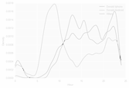
Our plan
?
Ask a question
Obtain data
Understand the world
Understand the data
Reports, Decisions, and Solutions
(today)
Modeling I: Intro to Modeling, Simple Linear Regression, Loss functions

Slide 3
Introduction to Modeling
Understanding the usefulness of models

Slide 4
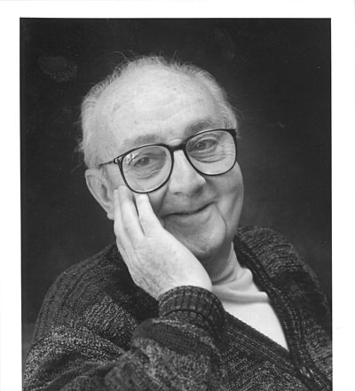
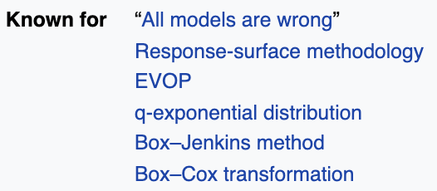
What is a Model?
Essentially, all models are wrong, but some are useful.
A model is an idealized representation of a system.
Example: We model the fall of an object on Earth as subject to a constant acceleration of 9.81 m/s² due to gravity.
While this describes the behavior of our system, it is merely an approximation.
It doesn’t account for the effects of air resistance, local variations in gravity, etc.
But in practice, it’s accurate enough to be useful!
George Box, Statistician (1919-2013)
Notes:
Since all models gloss over some details (i.e. make some simplifying assumptions), they’re all wrong.
But if the assumptions aren’t too egregious, these models can still be useful.
George Box: https://en.wikipedia.org/wiki/George_E._P._Box "one of the great statistical minds of the 20th century" 1919-2013

Slide 5
Three Reasons for Building Models
Reason 1:
To explain complex phenomena occurring in the world we live in.
How are the parents' average heights related to the children's average heights?
How do an object’s velocity and acceleration impact how far it travels?
Often times, we care about creating models that are simple and interpretable, allowing us to understand what the relationships between our variables are.
Reason 2:
To make accurate predictions about unseen data.
Can we predict if an email is spam or not?
Can we generate a one-sentence summary of this 10-page long article?
Other times, we care more about making extremely accurate predictions, at the cost of having an uninterpretable model. These are sometimes called black-box models, and are common in fields like deep learning.
Reason 3:
To make causal inferences about if one thing causes another thing.
Can we conclude that smoking causes lung cancer?
Does a job training program cause increases in employment and wage?
Much harder question because most statistical tools are designed to infer association not causation
This won’t be the focus of this class, but will be if you go on to take more advanced classes.
Most of the time, we want to strike a balance between interpretability and accuracy.

Slide 6
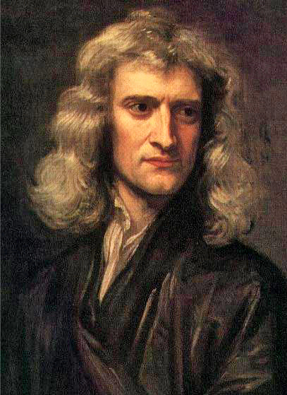
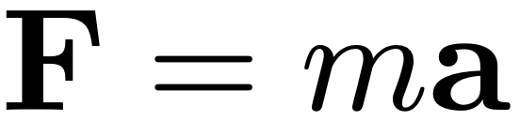

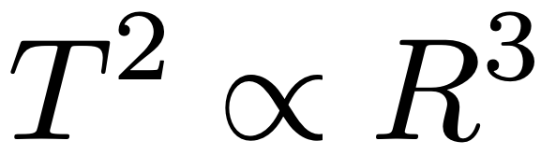
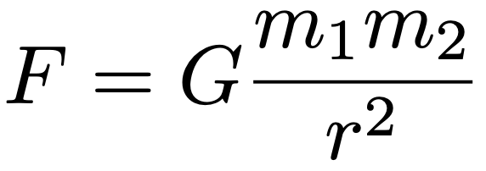
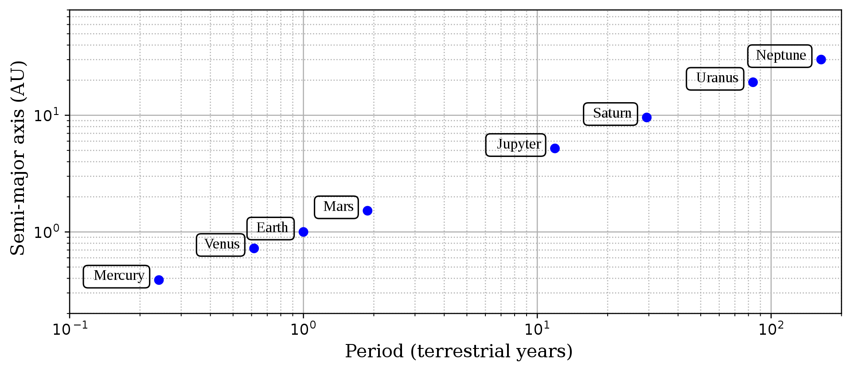
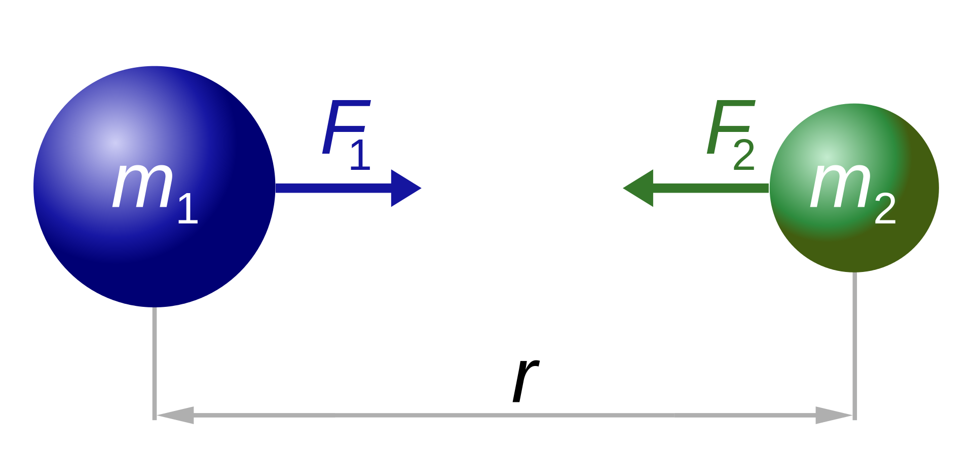
Common Types of Models
Deterministic physical (mechanistic) models: Laws that govern how the world works.
Newton's Laws: motion and gravitation (1687)
Newton’s second law of motion models the relationship between the mass of an object and the force required to accelerate it.
Kepler's Third Law of Planetary Motion (1619)
The ratio of the square of an object's orbital period with the cube of the semi-major axis of its orbit is the same for all objects orbiting the same primary.
Notes:
Some models, such as the aforementioned model of the acceleration due to gravity on Earth, are laws that govern how the world works. We call these physical models.
On the right, we Newton’s second law of motion, that models the relationship between the mass of an object and the force required to accelerate it.
On the left, we have the results of a study involving one of Einstein’s equations(?) that model the behavior of gravitational waves. The top row shows empirically collected data, and the middle row shows Einstein’s model. Pretty good!
http://hyperphysics.phy-astr.gsu.edu/hbase/Newt.html

Slide 7
Common Types of Models
Probabilistic models
Models of how random processes evolve.
Often motivated by understanding of an unpredictable system.
Examples: Bayesian networks, Markov models
Notes:
A probabilistic model is a model that explicitly represents uncertainty.
Instead of giving one fixed outcome, it describes how likely different outcomes are.
You can say something like:
“Most real‑world systems are noisy and unpredictable. Probabilistic models don’t try to eliminate the randomness — they model it. They describe how a random process behaves and evolves over time.”
Weather: We can’t say it will rain, but we can predict a probability of rain. Bayesian Networks
Graphs showing how variables influence each other probabilistically.
Nodes = variables
Edges = cause/effect or dependency
Useful when you want to understand the structure of uncertainty (e.g., medical diagnosis).
Markov Models
Models where the next state depends only on the current state, not the full history (“memoryless”).
Useful for sequences and processes evolving over time (e.g., speech recognition, stock movement, weather states).

Slide 8
Review: Regression Line & Correlation

Slide 9
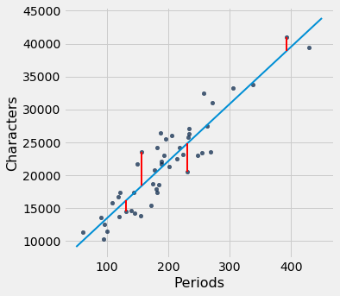

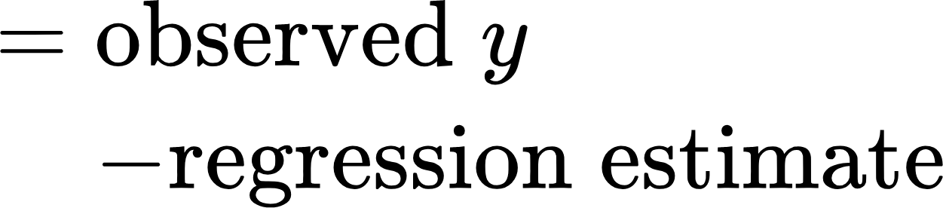


The Regression Line
The regression line is the unique straight line that minimizes the mean squared error of estimation among all straight lines.
For every chapter of the novel Little Women, Estimate the # of characters based on the number of periods in that chapter.

Slide 10
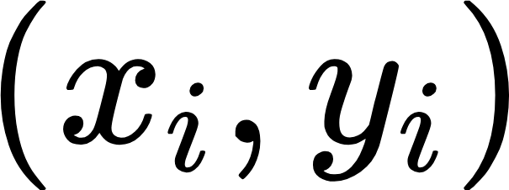


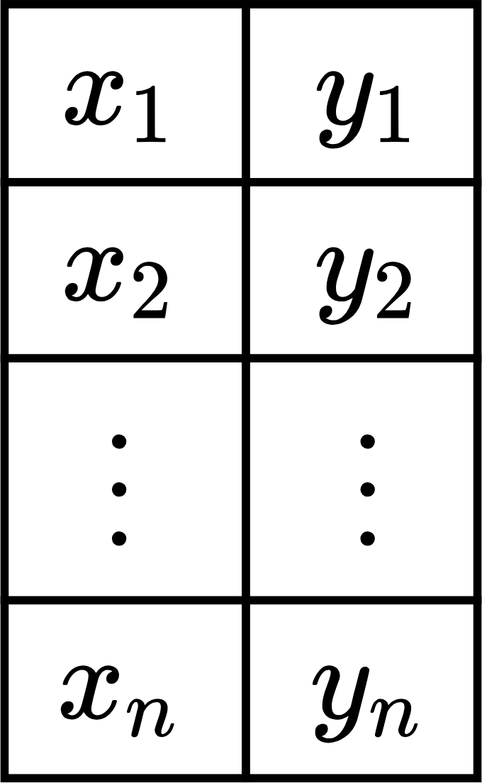
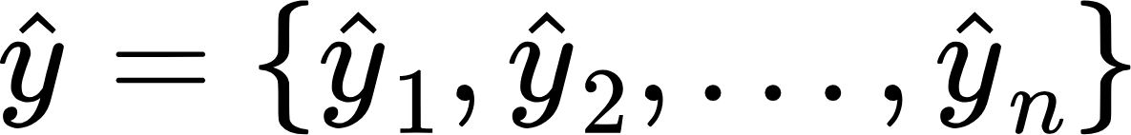
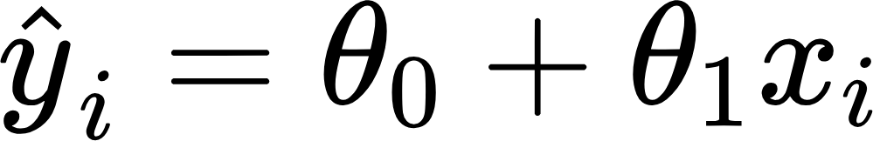
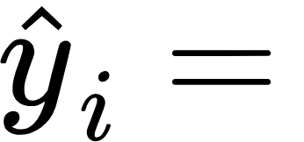
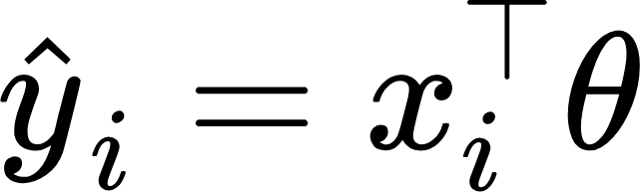
Models in DS
In DS, we’ll treat a model as some mathematical rule to describe the relationships between variables.
Dataset
Observation
Prediction
If we use to predict , the predictions are denoted as
Independent variable
Input
Feature
Attribute
Dependent variable
Output
Outcome
Response
Models
Parametric models

Slide 11
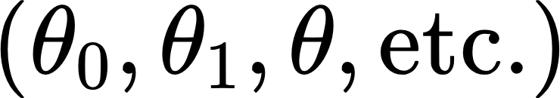





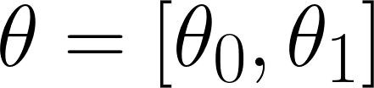

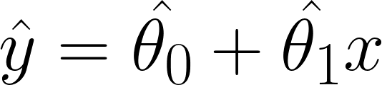
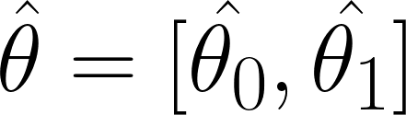
Models in DS: Parametric Models
Parametric models are described by a few parameters
No one tells us the parameters: the data informs us about them.
The values are not parameters because we directly observe them.
Sample-based estimate of parameter is written as .
Usually, we pick the parameters that appear "best" according to some criterion we choose.
Any linear model with parameters
Model parameter(s)
Estimated parameter(s), “best” fit to data in some sense
The "best" fitting linear model with parameters

Slide 12
Models in DS: Parametric Models
Parametric models are described by a few parameters
No one tells us the parameters: the data informs us about them.
The values are not parameters because we directly observe them.
Sample-based estimate of parameter is written as .
Usually, we pick the parameters that appear "best" according to some criterion we choose
Note: Not all statistical models have parameters!
k-Nearest Neighbor classifiers are non-parametric models.
Any linear model with parameters
Model parameter(s)
Estimated parameter(s), “best” fit to data in some sense
The "best" fitting linear model with parameters

Slide 13
The Modeling Process
1. Choose a model
How should we represent the world?
How do we quantify prediction error?
2. Choose a loss function
How do we choose the best parameters of our model given our data?
3. Fit the model
How do we evaluate whether this process gave rise to a good model?
4. Evaluate model performance

Slide 14
The Modeling Process
1. Choose a model
How should we represent the world?
How do we quantify prediction error?
2. Choose a loss function
How do we choose the best parameters of our model given our data?
3. Fit the model
How do we evaluate whether this process gave rise to a good model?
4. Evaluate model performance

Slide 15
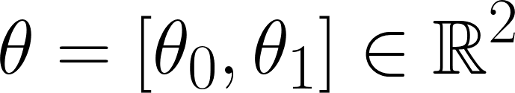

Simple Linear Regression: Our First Model
Simple Linear Regression Model (SLR)
SLR is a parametric model, meaning we choose the “best” parameters for slope and intercept based on data.
SLR
Note that the true relationship between and is usually non-linear. This is why (and not ) appears in our estimated linear model expression.
We often express as a single parameter vector.
is not a parameter! It is input to our model.

Slide 16
The Modeling Process
SLR model
1. Choose a model
How should we represent the world?
How do we quantify prediction error?
2. Choose a loss function
How do we choose the best parameters of our model given our data?
3. Fit the model
How do we evaluate whether this process gave rise to a good model?
4. Evaluate model performance

Slide 17
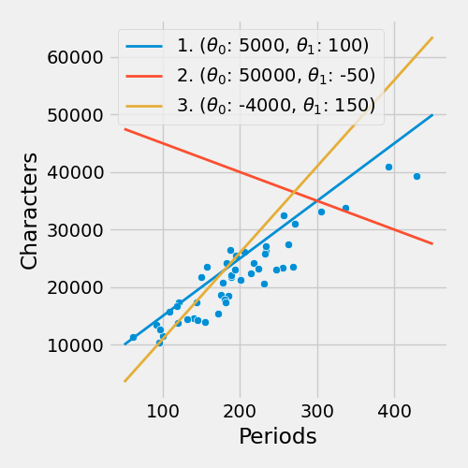
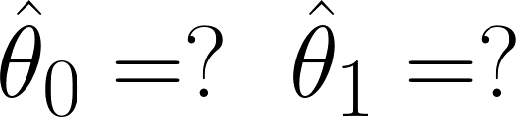
Which is best?
Based on your interpretation of the data, which are the "optimal parameters" for this linear model?
We only had 3 values to choose from to find the optimal parameter. In practice, our parameter domain is all reals, i.e.,
For every chapter of the novel Little Women, Estimate the # of characters based on the # of periods in that chapter.
🤔

Slide 18
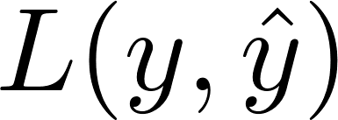
Loss Functions
We need some metric of how "good" or "bad" our predictions are.
A loss function characterizes the cost, error, or fit resulting from a particular choice of model or model parameters.
Loss quantifies how bad a prediction is for a single observation.
If our prediction is close to the actual value , we want low loss.
If our prediction is far from the actual value , we want high loss.
There are many definitions of loss functions!
The choice of loss function:
Affects the accuracy and computational cost of estimation.
Depends on the estimation task:
Are outputs quantitative or qualitative?
Do we care about outliers?
Are all errors equally costly? (e.g., false negative on cancer test)

Slide 19
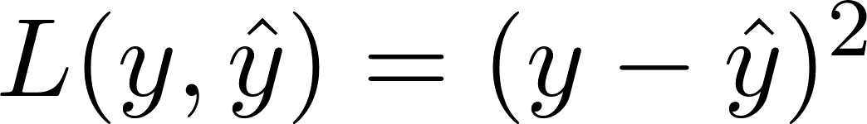
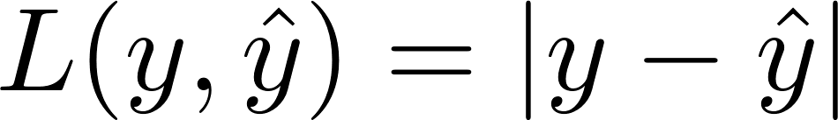
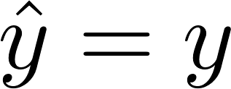
L2 and L1 Loss
Squared Loss
Widely used.
Also called "L2 loss".
Reasonable:
→ good prediction → good fit → no loss
far from → bad prediction → bad fit → lots of loss
Absolute Loss
Also called "L1 loss".
Reasonable:
→ good prediction → good fit → no loss
far from → bad prediction → bad fit → some loss

Slide 20
Why don't we use residual error directly and instead we use absolute loss or squared loss?
Notes:
📣 This is Slido interaction slide, please don't delete it. ✅ Click on 'Present with Slido' and the poll will launch automatically when you get to this slide.

Slide 21
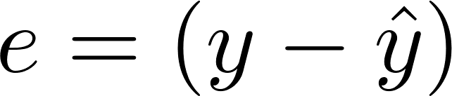
Residuals as loss function?
Why don't we directly use residual error as the loss function?
Doesn't work: big negative residuals shouldn't cancel out big positive residuals!
Our predictions can be very off, but we can still get a zero residual.

Slide 22
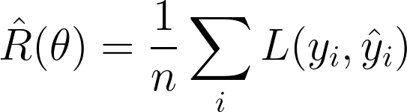
Empirical Risk is Average Loss over Data
We care about how bad our model’s predictions are for our entire data set, not just for one point.
A natural measure, then, is of the average loss (aka empirical risk) across all points.
Given data :
Function of the parameter (holding the data fixed) because determines .
The average loss on the sample tells us how well the model fits the data (not the population).
But hopefully these are close.
Notes:
If our model has a low average loss across our dataset, that means it is good at making predictions.

Slide 23
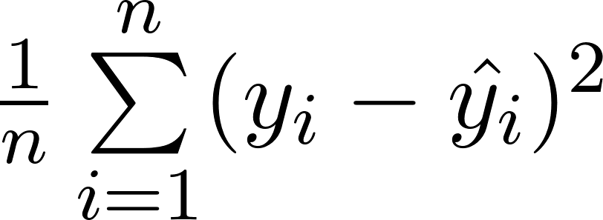
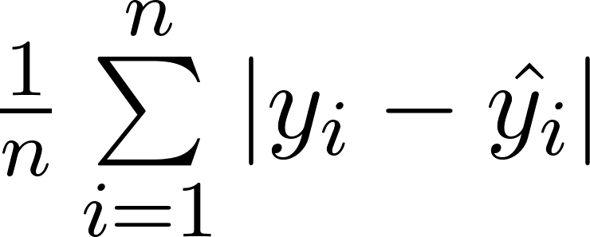
Empirical Risk is Average Loss over Data
We care about how bad our model’s predictions are for our entire data set, not just for one point.
A natural measure, then, is of the average loss (aka empirical risk) across all points.
Given data :
L2 loss
Mean Squared Error (MSE)
The colloquial term for average loss depends on which loss function we choose.
Mean Absolute Error (MAE)
L1 loss
Notes:
If our model has a low average loss across our dataset, that means it is good at making predictions.

Slide 24
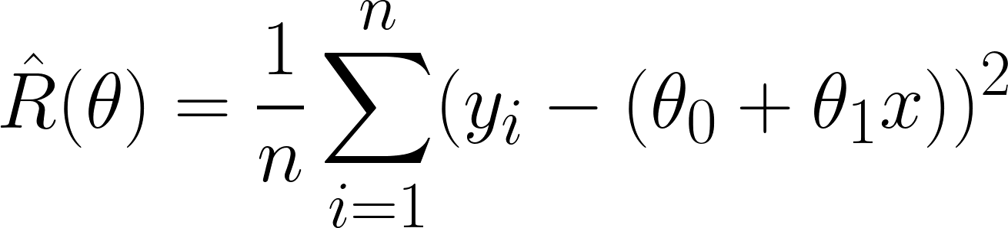
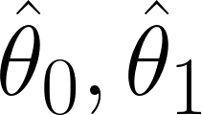
The Modeling Process
1. Choose a model
How should we represent the world?
Squared loss
How do we quantify prediction error?
2. Choose a loss function
How do we choose the best parameters of our model given our data?
3. Fit the model
We want to find that minimize
this objective function.
How do we evaluate whether this process gave rise to a good model?
4. Evaluate model performance

Slide 25
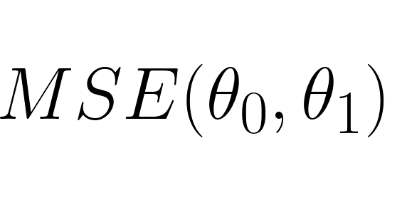
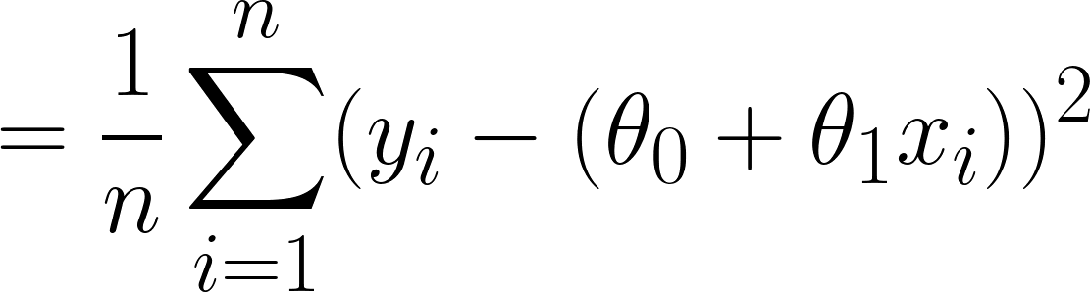
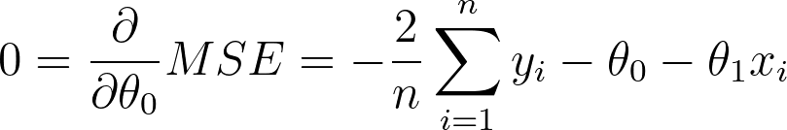
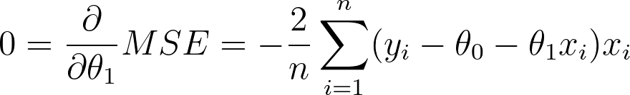
Minimizing MSE for the SLR Model
Recall: we wanted to pick the regression line
To minimize the (sample) Mean Squared Error:
To find the best values, we set derivatives equal to zero to obtain the optimality conditions:

Slide 26

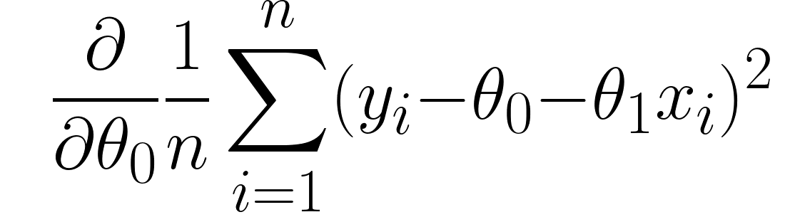
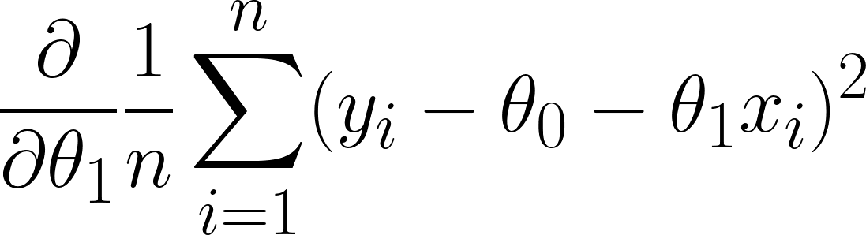
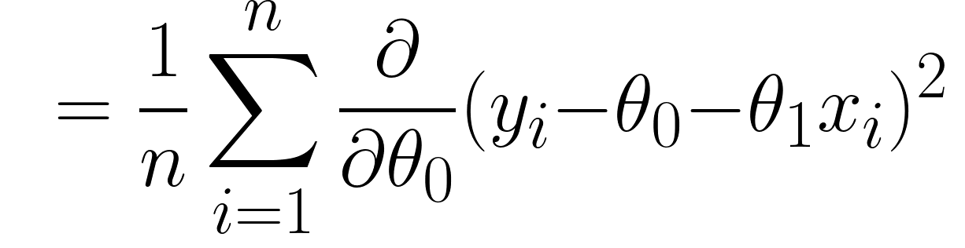
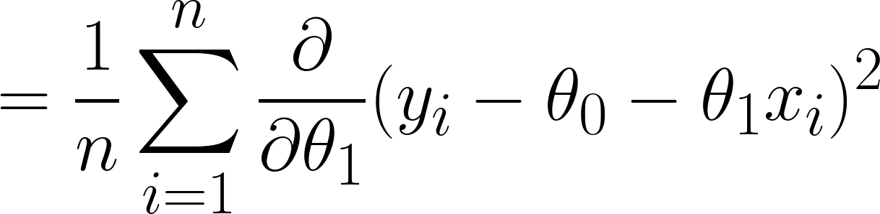
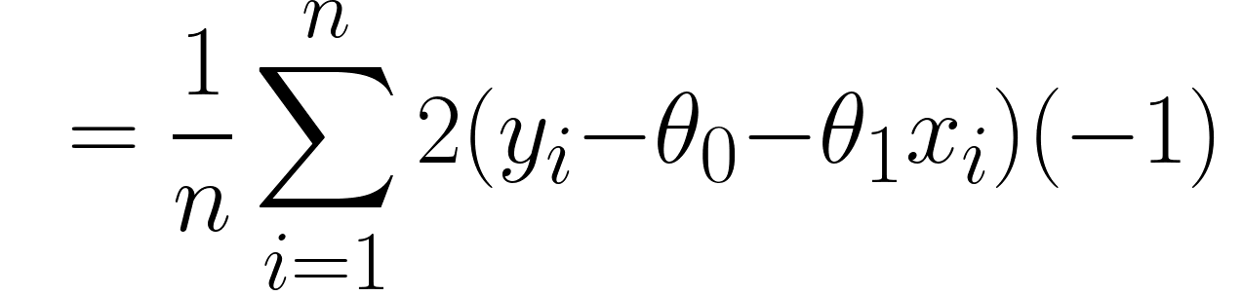
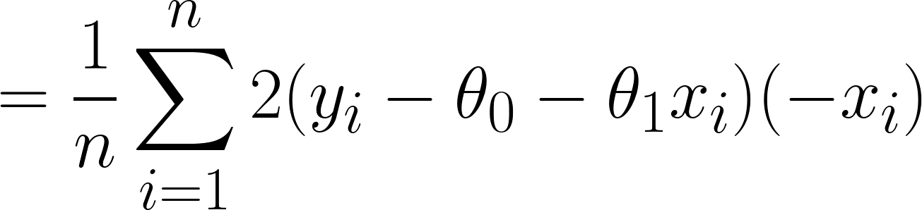
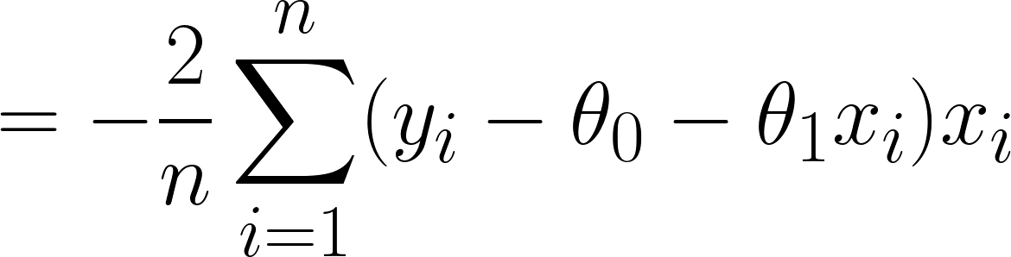
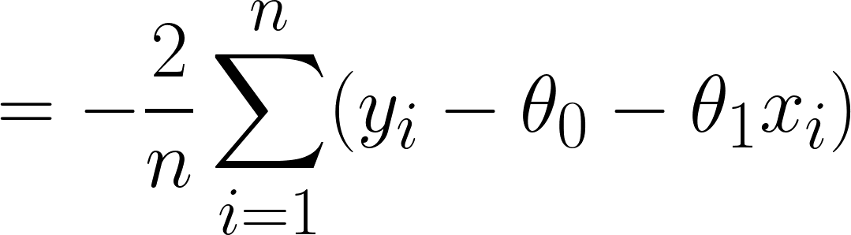
Partial Derivative of MSE with Respect to
Derivative of sum is sum of derivatives
Derivative of sum is sum of derivatives
Chain rule
Chain rule
Simplify constants
Simplify constants
Notes:
\frac{\partial}{\partial \theta_0}\frac{1}{n}\sum_{i=1}^{n}(y_i - \theta_0-\theta_1x_i)^2 = \frac{1}{n}\sum_{i = 1}^{n} \frac{\partial}{\partial \theta_0}(y_i - \theta_0-\theta_1x_i)^2 = \frac{1}{n}\sum_{i=1}^{n}2(y_i- \theta_0- \theta_1x_i)(-1) = -\frac{2}{n}\sum_{i=1}^{n}(y_i-\theta_0-\theta_1x_i)

Slide 27
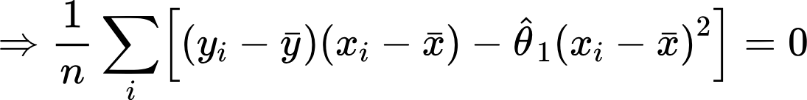
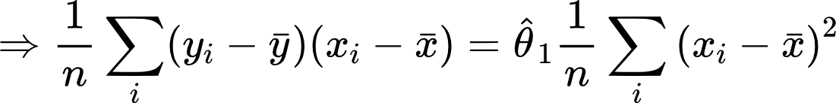
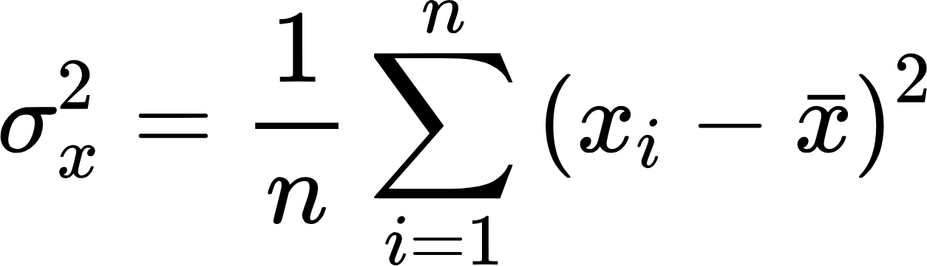
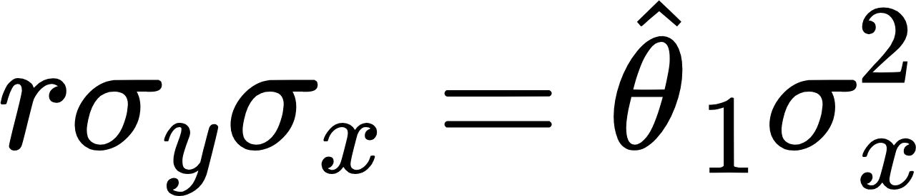



From Estimating Equations to Estimators
Reminder
Plug in definitions of correlation and SD:
Solve for :

Slide 28



The Modeling Process
1. Choose a model
How should we represent the world?
Squared loss
How do we quantify prediction error?
2. Choose a loss function
How do we choose the best parameters of our model given our data?
3. Fit the model
We want to find that minimize
this objective function.
How do we evaluate whether this process gave rise to a good model?
4. Evaluate model performance

Slide 29
The Modeling Process
1. Choose a model
How should we represent the world?
Squared loss
How do we quantify prediction error?
2. Choose a loss function
How do we choose the best parameters of our model given our data?
3. Fit the model
We want to find that minimize
this objective function.
How do we evaluate whether this process gave rise to a good model?
4. Evaluate model performance

Slide 30


Evaluating Models
What are some ways to determine if our model was a good fit to our data?
Visualize data, compute statistics:
Plot original data. Compute column means, standard deviation. If we want to fit a linear model, compute correlation.
Performance metrics:
Root Mean Square Error (RMSE)
It is the square root of MSE, which is the average loss that we've been minimizing to determine optimal model parameters.
RMSE is in the same units as y.
A lower RMSE indicates more "accurate" predictions (lower "average loss" across data)
Visualization:
Look at a residual plot of to visualize the difference between actual and predicted values.

Slide 31

Four datasets with the same MSE
Before modeling, you should always visualize your data first!

Slide 32





The residual plot of a good regression shows no pattern.

Slide 33
The Modeling Process
1. Choose a model
SLR model
Squared loss
L2 Loss
Mean Squared Error (MSE)
2. Choose a loss function
Minimize average loss with calculus
3. Fit the model
We want to find that minimize
this objective function.
Visualize, Root MSE
4. Evaluate model performance

